Slide 1


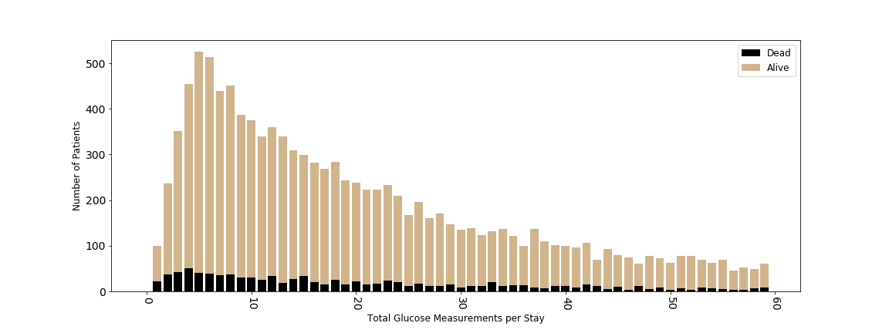
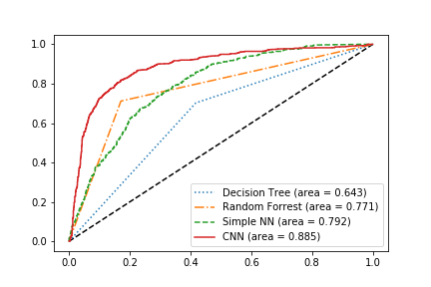
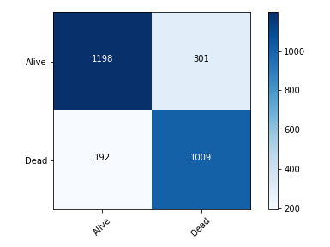
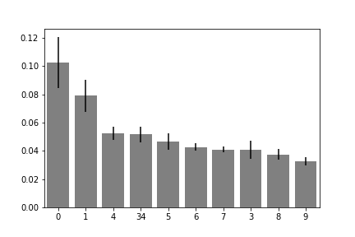
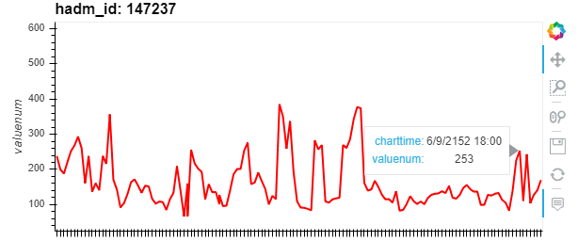
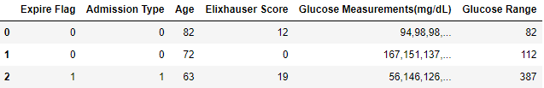
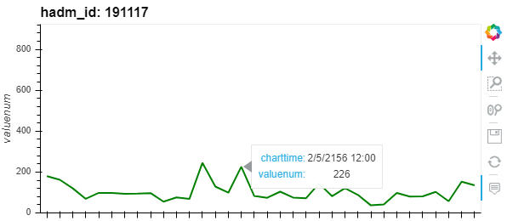
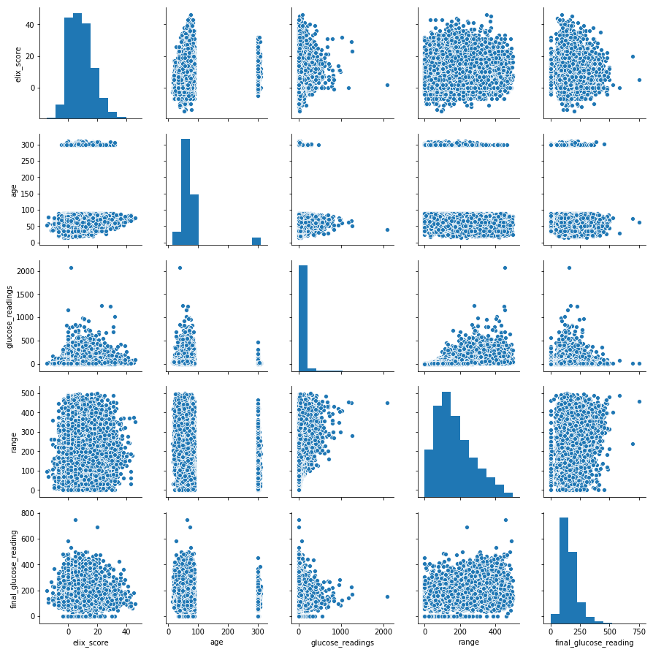
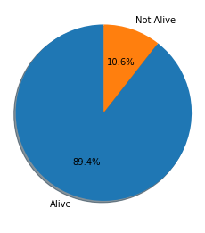
Predicting Mortality of Diabetic ICU Patients
Ian Wittler | Dr. Xinlian Liu | Dr. Aijuan Dong | Hood College of Frederick Maryland
Abstract
Preprocessing
Data Splitting
Diabetes mellitus (DM) is a major public health concern that requires continuing medical care. It is also a leading cause of other serious health complications associated with longer hospital stays and increased mortality rates. Fluctuation of blood glucose levels are easy to monitor. Physicians manage patients' blood glucose to prevent or slow the progress of diabetes. In this research, the MIMIC-III data set was used to develop and train multiple models that aimed to predict the mortality of DM patients. Our deep learning model of convolutional neural network produced a 0.885 AUC score, above all baseline models we constructed, which include decision trees, random forests, and fully connected neural networks. By analyzing the features that drive these models, care management for diabetic patients in an ICU setting can be improved resulting in lowered mortality rates.
For data balancing purposes, a combination of over-sampling and under-sampling was performed. The resulting sampled data was split 70-15-15 training, testing, and validation.
Results
Figure 3: Glucose Measurements per Stay
It was found that the final 30
blood glucose measurements
before discharge or death were the
most impactful measurements.
Additionally, the Elixhauser
comorbidity score was the most
important feature.
Figure 7: AUC Results
Figure 8: CNN Confusion Matrix
Four models were evaluated using AUC seen in figure 7. The CNN produced the best results with a 0.885 AUC score. The improvement in score obtained from the CNN model suggest that blood glucose measurements do serve as an important factor for modeling diabetic patient mortality.
Visualization
Figure 4: Feature Importance
Data Description
In the data set, 20% (11820/58976) of all patients had diabetes ICD9 codes. Figure 2 breaks down the diabetic patients into two class: alive (89.4%) and not alive (10.6%). These classes represent what each model in this research aims to predict. The imbalance of classes played a role into how the data was split and sampled before training. Another visualization tool, used for graphing patient’s blood glucose measurements, can be seen in figure 1. By observing these
graphs, changes in patient’s blood
glucose values are noticeable. With the
above figure, the red line is used to
represent dead patients and the green
line to represent alive patients.
Future Work
Determining how blood glucose measurements can impact other hospital events (such medication distribution, unit transfers, surgeries, etc.) could prove to be an interesting follow up study. This information could help to understand:
What glucose treatments are most desired for positive outcomes.
How glucose measurement can be used to predict different events.
Figure 5: Three Sample Rows of Reduced Input Features
After preprocessing and feature reduction was performed, the final data frame consisted of 5 variables (seen in figure 5).
Figure 1: Two Patient Glucose Measurements
Acknowledgements and References
I would like to thank Dr. Miranda Darby of the Bioinformatics Program, Dr. Andrew Campbell of the Counseling Program, Dr. Linda Kennedy of the Nursing Program, and Dr. Silvia Crivelli of the Lawrence Berkeley National Laboratory for their invaluable insights and constructive criticisms.
This work used the Extreme Science and Engineering Discovery Environment (XSEDE). Specifically, it used the Bridges system, at the Pittsburgh Supercomputing Center (PSC) through an educational allocation TG-ASC190003.
Figure 2: Mortality Distribution
Figure 6: Feature Pair Plot

